Slide 1
Bangladesh University of Business and Technology
Web Database Programming
Project Name: ERP System for eBay.in Sellers
Submitted By:
Md. Azizur Rahman
Md. Nazmul Haque
Department Of Computer Engineering
Supervised By:
Sadah Anjum Shanto
Department Of Computer Engineering BUBT

Slide 2
OUTLINE
Introduction
Aim Of ERP
Problem Statement
Context Diagram
Goals of the ERP Project
Limitations of ERP
Features Of ERP
Users / Actors Of System
Login
Forget Password
Admin Dashboard
HR Dashboard

Slide 3
OUTLINE
Add Employees
Employees List
Employees Update
Inventory Dashboard
Add Product
Update Product
Product List
Sales Dashboard
Add Sales Product
Update Sales
Sales List
Email
Profit Calculation

Slide 4
OUTLINE
Admin Features(privileges )
HR Features(privileges )
Sales Manager Features(privileges )
Manufacture Manager Features(Privileges )
Future SCOPE
Conclusion

Slide 5
Introduction
ERP is a Set of application software that brings financial, distribution, manufacturing, and other business functions into balance. It extends horizontally across the company’s business functions and vertically throughout the company’s supply chain.

Slide 6
To know importance of enterprise resource planning Today, ERP is a widely applied software system in all types of industrial fields including small and medium sized companies. Inventory control, better human capital management, customer relationship management and order tracking are some among the key benefits of implementing enterprise resource planning.
Aim Of ERP

Slide 7

Problem Statement
To Developed a system That will manage
Activities of the various Manager
Information about sales , inventory, profit calculations
Employees Management
Access right of multilevel managers

Slide 8
Context Diagram:
HR
Sales
Inventory
Product
Management
Administrator
Under Processing …….
Sales
Product Availability
Product Availability
Inventory
Employee(HR)
Views Info

Slide 9
Goals of the ERP Project
Improve effectiveness and efficiency of Business and administrative processes
Improve support for decision making
Enhance availability and access to timely and reliable information
Enhance professional capabilities of human resources , inventory, sales etc
Improve quality of services for all stakeholders
Enhance accountability of personnel, and integrity of processes and information.
Automate Business Solutions.
Increase Operating Efficiency.

Slide 10
Limitations of ERP
▪ High cost.
▪ Forced change of processes.
▪ Very complex software.
▪ Lack of trained people.
▪ Flexibility of software system upgrades.
▪ Implementation timelines.
▪ Availability of internal technical knowledge and resources.
▪ Education and training.
▪ Implementation strategy and execution.
▪ Resistance to change.

Slide 11
Features Of ERP
The primary objective behind the development of the “ERP System for eBay Sellers” is as follows:
1. One click profit and loss calculation before selling product on ebay.in.
2. This ERP System will improve Customer Service.
3. Easy manageable Inventory System.
4. Centralized Data.
6. Integrated Gmail to send preened template to employee, like salary received Mail,
8. Friendly GUI Interface.

Slide 12
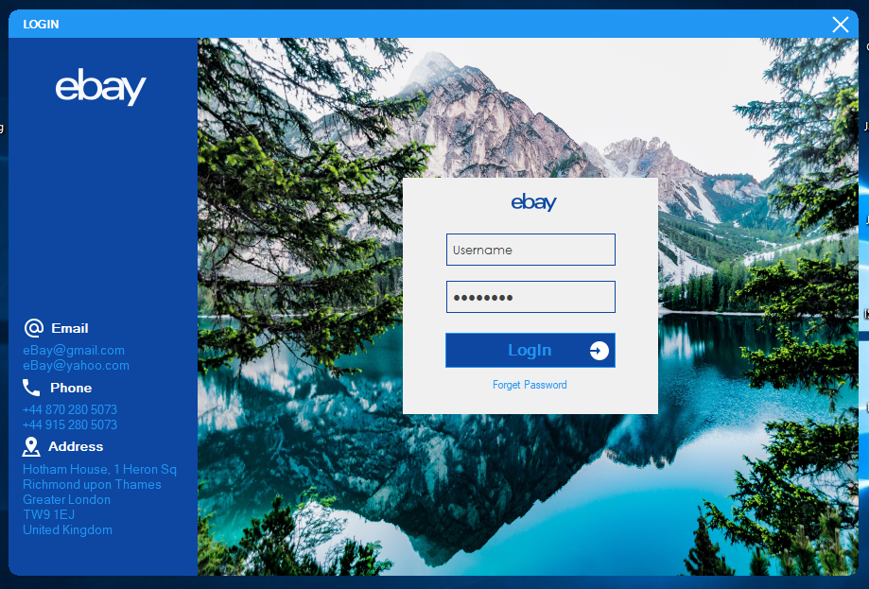
Users / Actors Of System
Admin
HR / Manager

Slide 13
Login: Name password

Slide 14
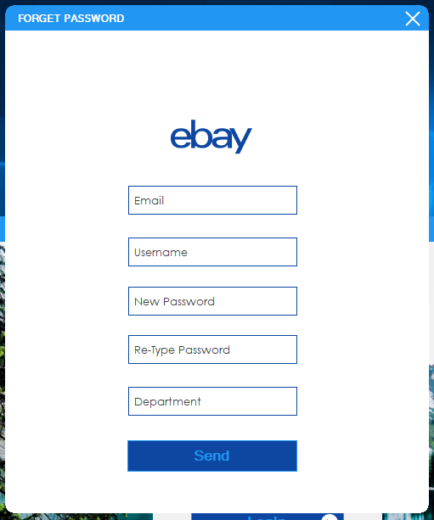
Forget Password: Email username new password Re-type Password Department

Slide 15
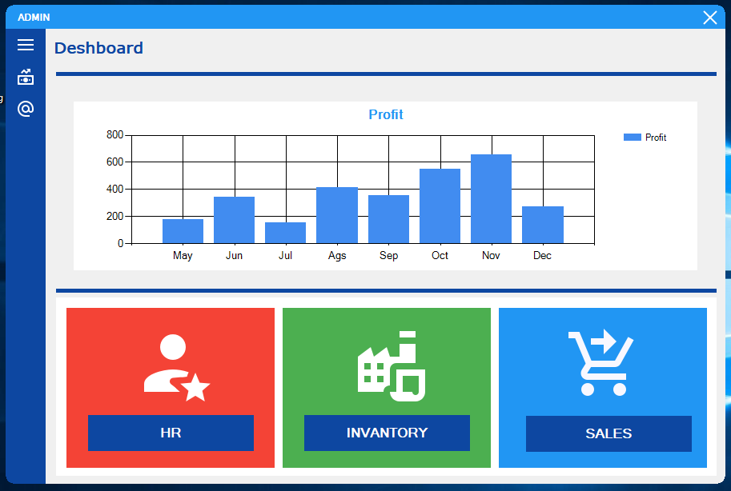
Admin Dashboard: HR INVERTORY SALES

Slide 16
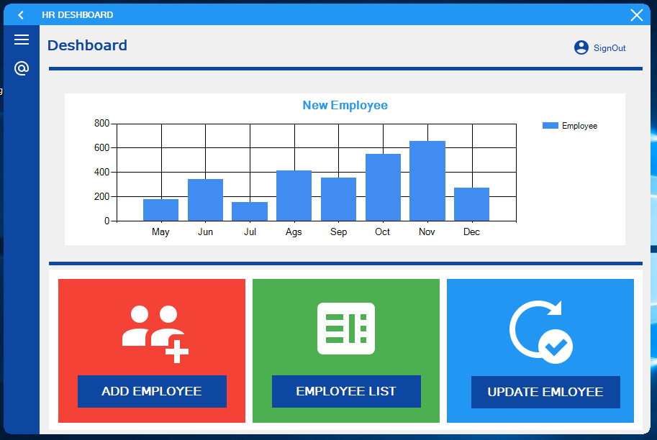
HR Dashboard

Slide 17
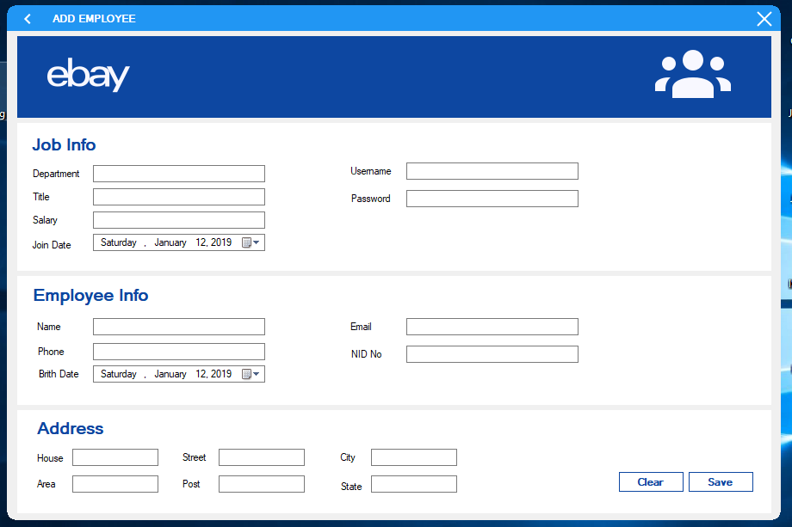
Add Employees

Slide 18
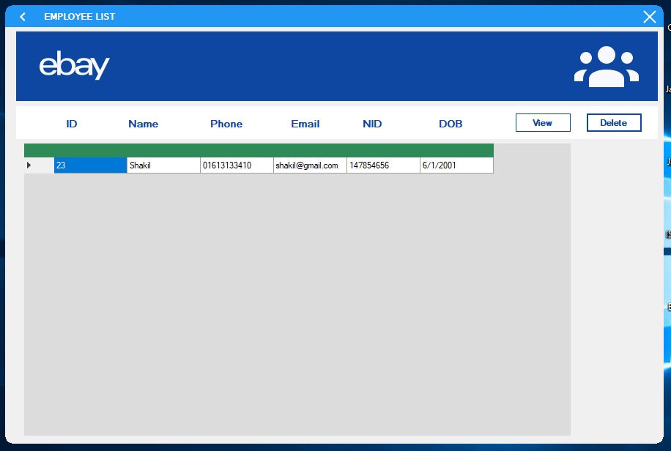
Employees List

Slide 19
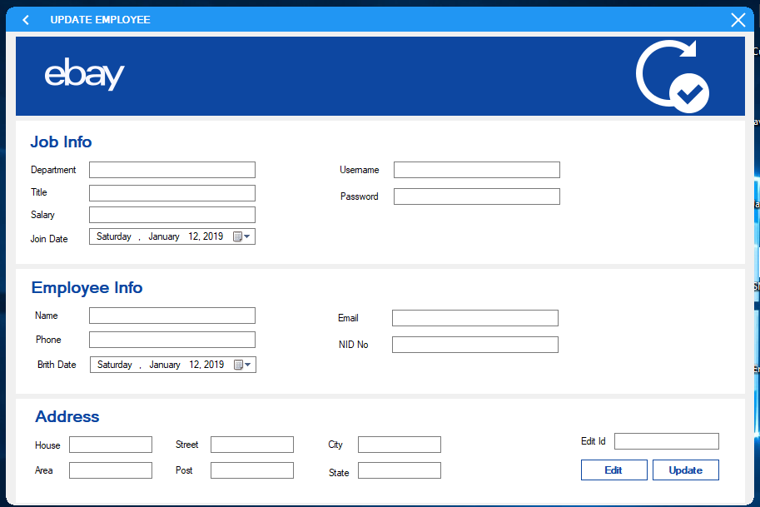
Employees Update

Slide 20
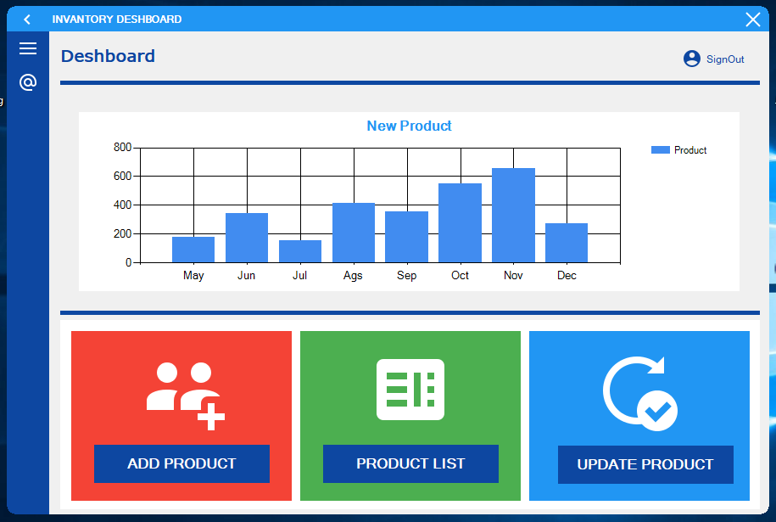
Inventory Dashboard

Slide 21
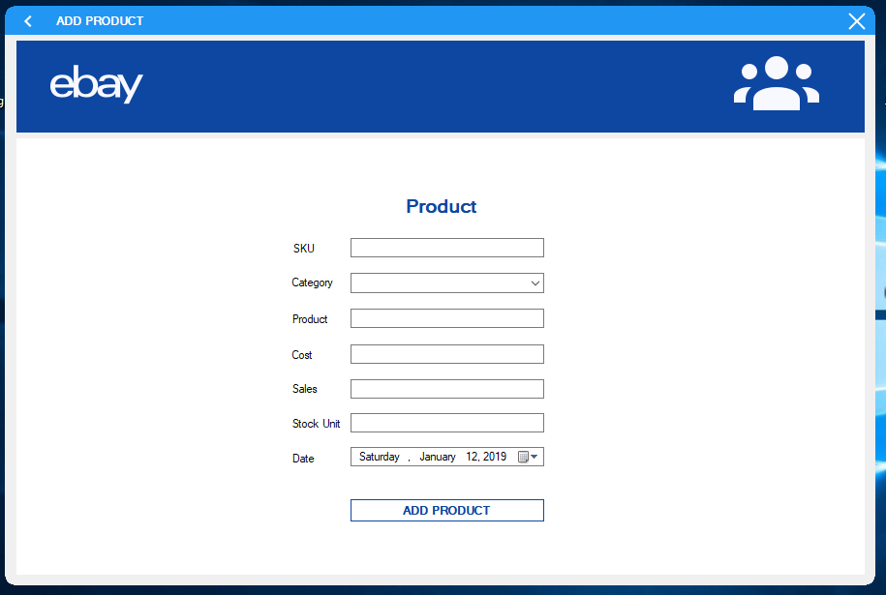
Add Product

Slide 22
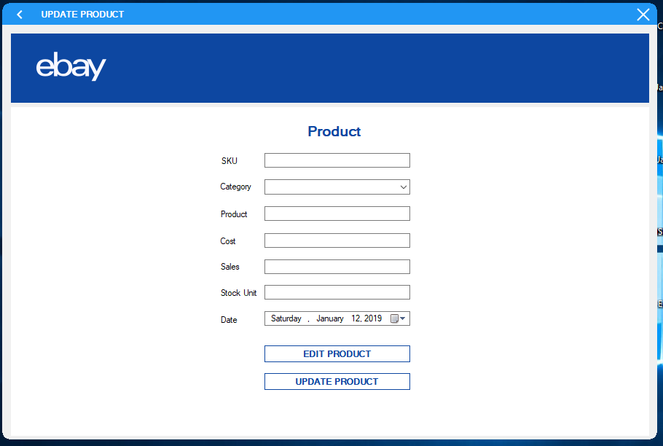
Update Product

Slide 23
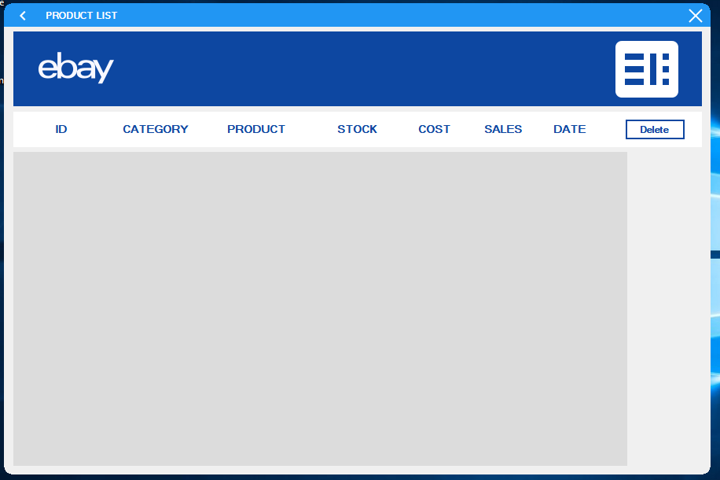
Product List

Slide 24

Sales Dashboard

Slide 25
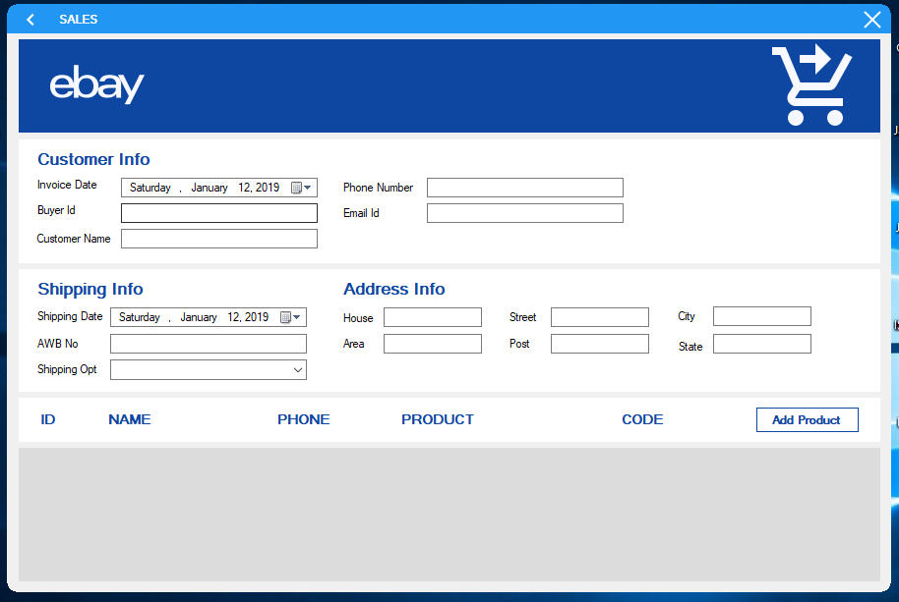
Add Sales Product

Slide 26
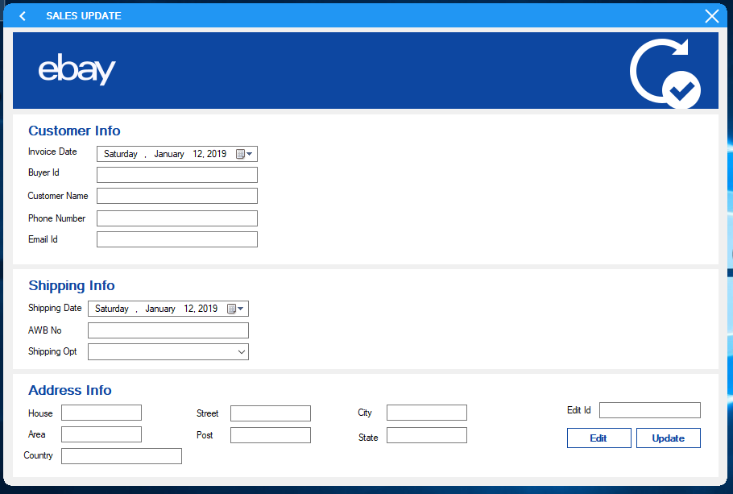
Update Sales

Slide 27
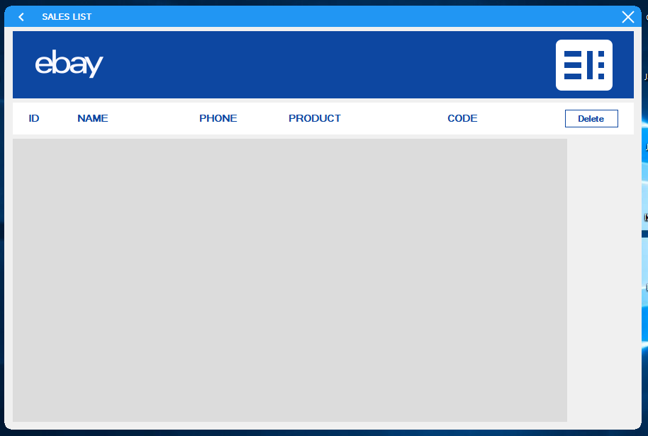
Sales List

Slide 28
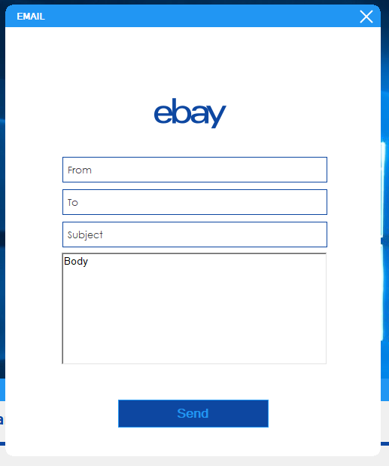
Email

Slide 29
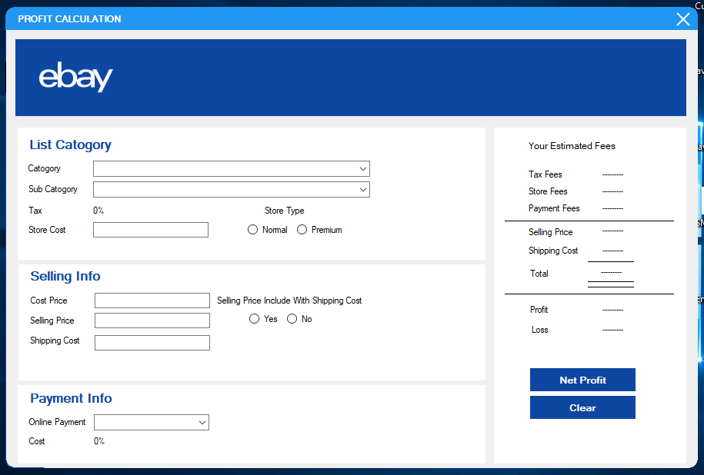
Profit Calculation

Slide 30

Admin Features(privileges )
Admin has all of the authorizations to access.
Permission to Add, Update, Views and Delete.
Sends Email
Profit calculations

Slide 31
HR Features(privileges )
HR can Add employees
Change any information of any employees.
View of employees.
Update Employees.
Also delete Employees.

Slide 32

Sales Manager Features(privileges )
Manager can Sales products
Views sales list
Update Sales

Slide 33
Manufacture Manager Features(Privileges )
Manager can Sales products
Views sales list
Update Sales

Slide 34
Future SCOPE:
Improved BI and reporting
Mobility and wearable technology to turn dominant.
More user-friendly ERP systems.
Cloud ERP
New Market
New channels

Slide 35
Conclusion
While employing an ERP system may be expensive, it offers organizations a cost efficient system in the long run.
ERP software works by integrating all the different departments in on organization into one computer system allowing for efficient communication between these departments and hence enhances productivity.

Slide 36
THANK YOU

